Slide 1


Common-Mode fundamentals for
Shipboard Power Systems
Part 6
Impact of CM Choke on CM Voltage of power electronics
Dr. Norbert Doerry
Dr. John Amy
http://doerry.org/norbert/MarineElectricalPowerSystems/index.htm
© 2025 by Norbert Doerry and John Amy
This work is licensed via: CC BY 4.0 (https://creativecommons.org/)

Slide 2
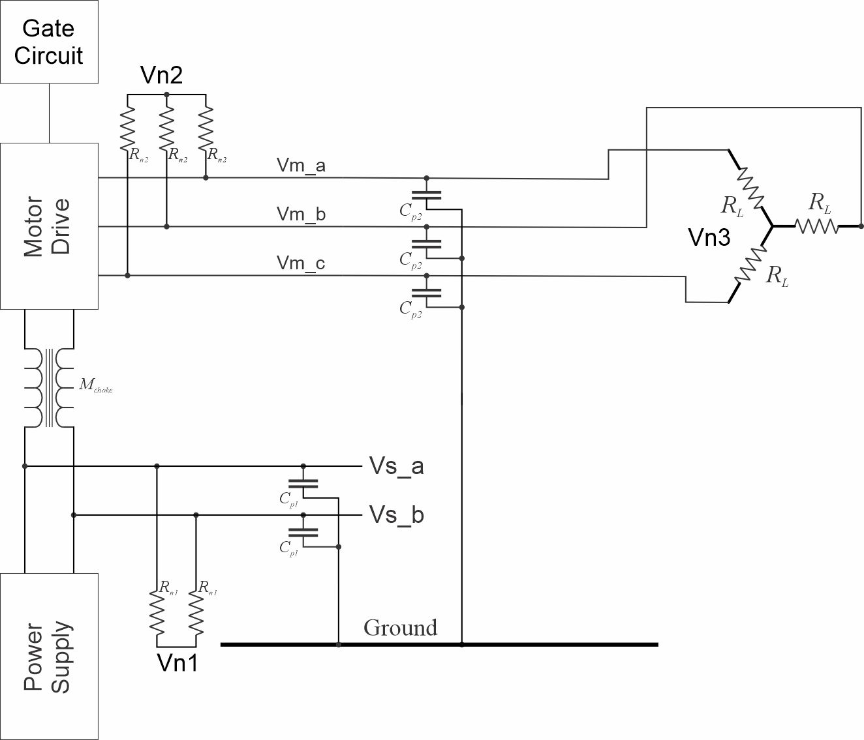
Example Power Electronic Circuit
C_{p1} = 2.2 µF
C_{p2} = 2.2 µF
R_{n1} = 1200 Ω
R_{n2} = 1200 Ω
R_{L} = 300 Ω
M_{choke} = 0.2115 H
L_{choke} = 0.2175 H

Slide 3
Modeling Physical Components
IGBT
  On Resistance measured: 1.8 ohms
2.2 µF Capacitor
  Series Resistance measured: 52 ohms
  Resonant Frequency: ~ 40 kHz
Choke
  Series Resistance measured: 2.4 ohms
  Mutual Inductance measured: .2115 H
  Self Inductance measured = Mutual Inductance + .006 H

Slide 4
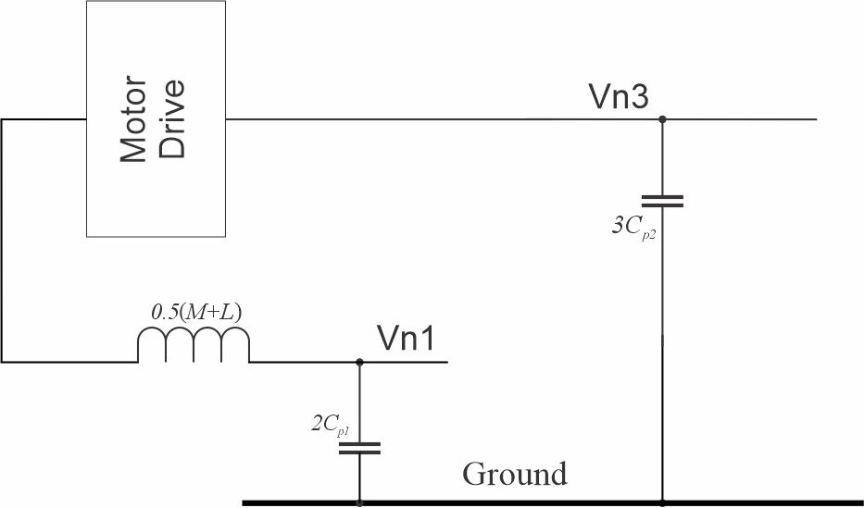
Example Power Electronic Circuit – CM model

Slide 5
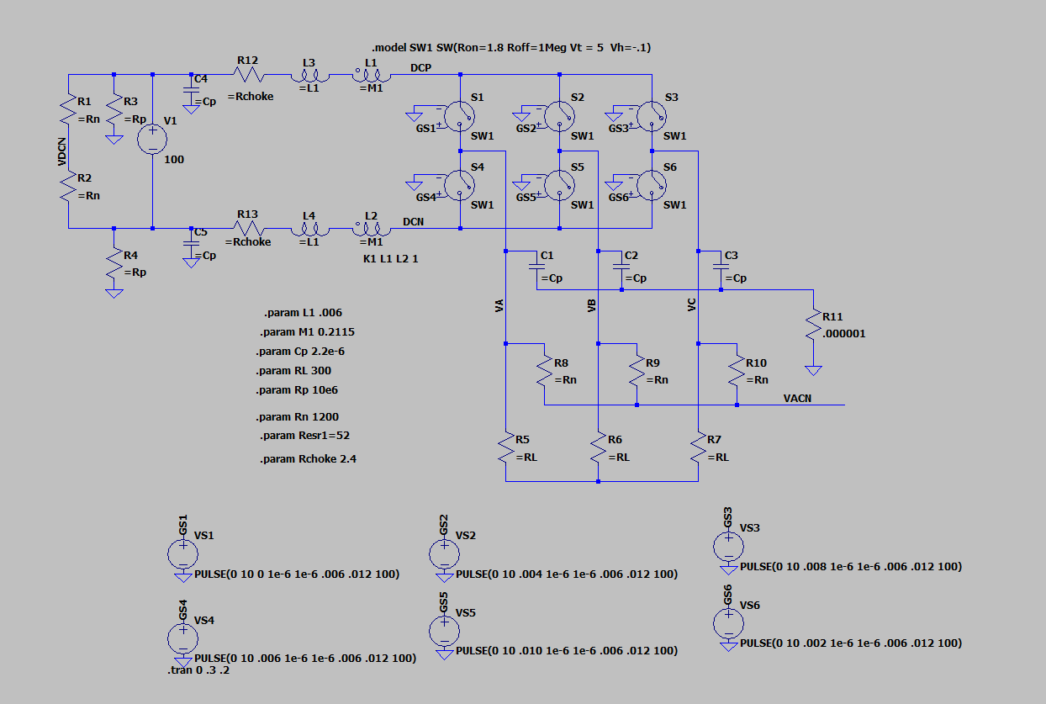
LTSpice Simulation
20250421 Inverter CM a.asc

Slide 6
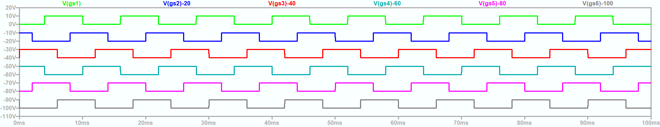
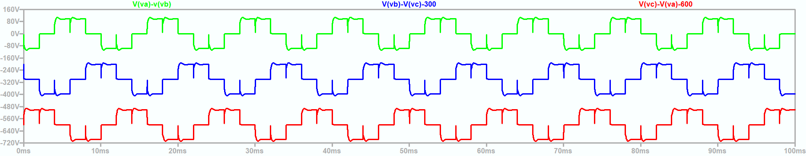
180° Mode modulation scheme
20250421 Inverter CM a.asc

Slide 7
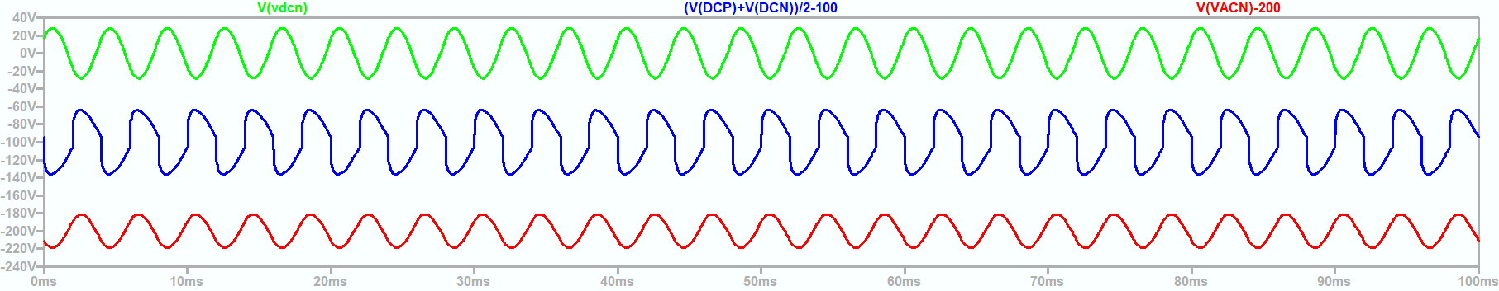
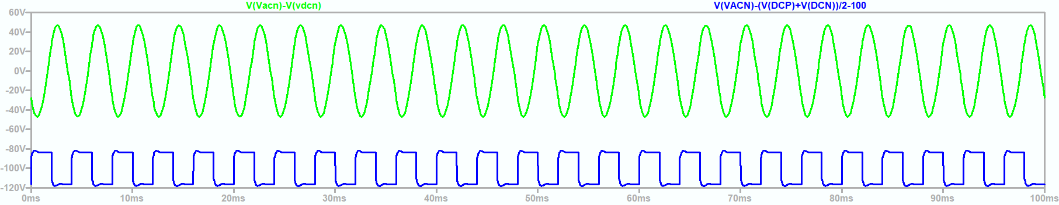
Common Mode Voltages (180 ° Mode)
20250421 Inverter CM a.asc

Slide 8
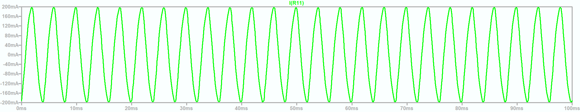
Common Mode Current (180 ° Mode)
20250421 Inverter CM a.asc

Slide 9
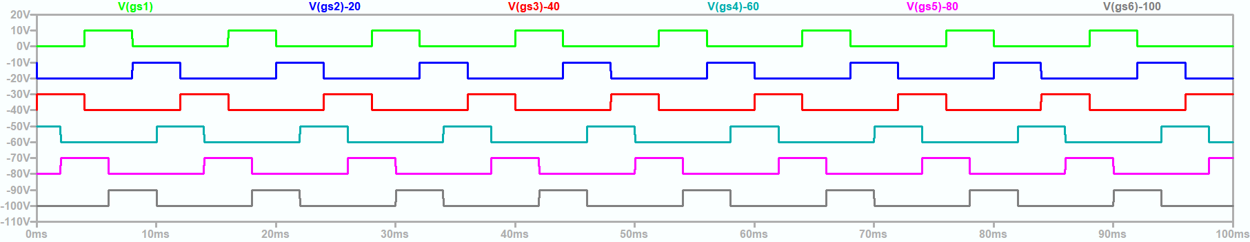
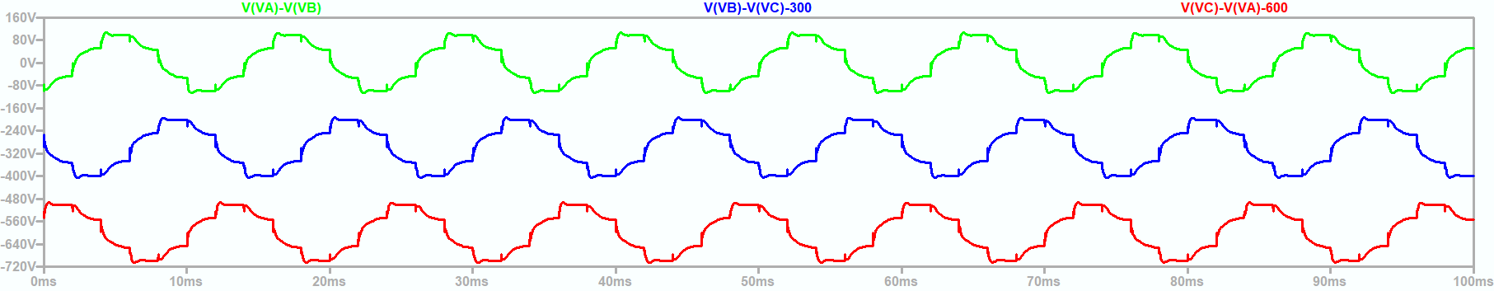
120° Mode modulation scheme
20250421 Inverter CM b.asc

Slide 10
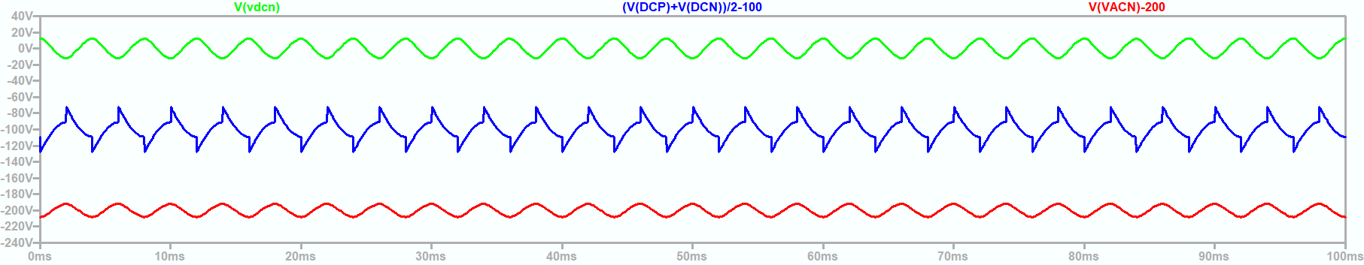
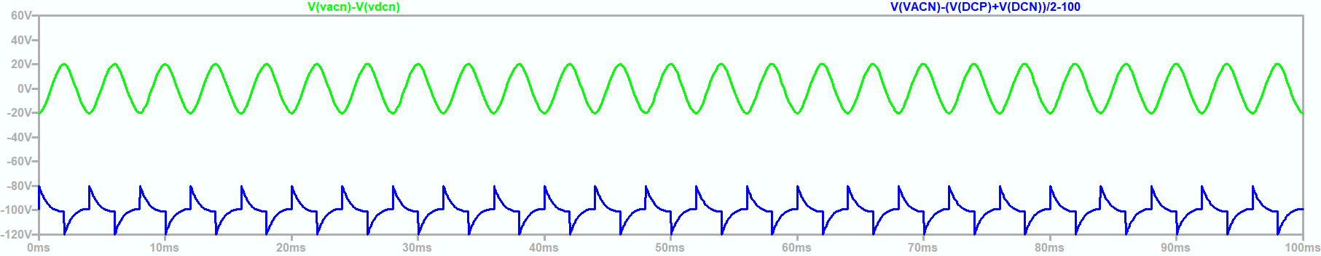
Common Mode Voltages (120 ° Mode)
20250421 Inverter CM b.asc

Slide 11
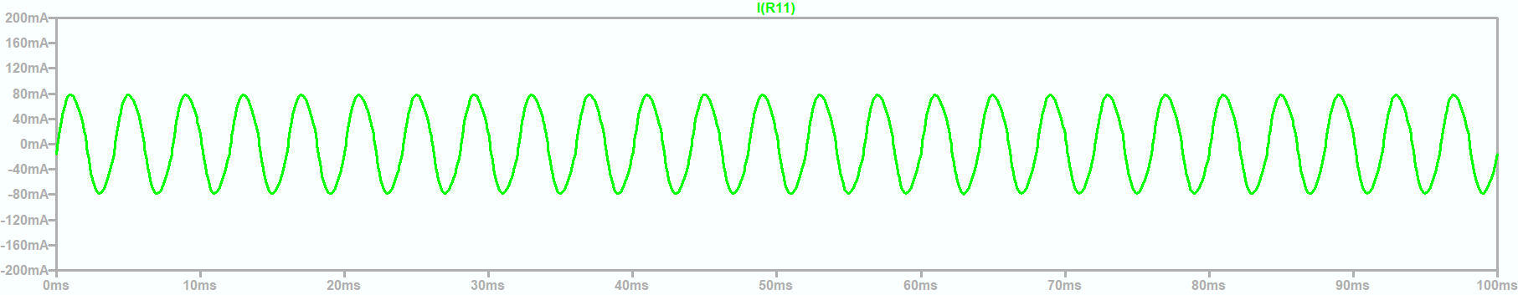
Common Mode Currents (120 ° Mode)
20250421 Inverter CM b.asc

Slide 12
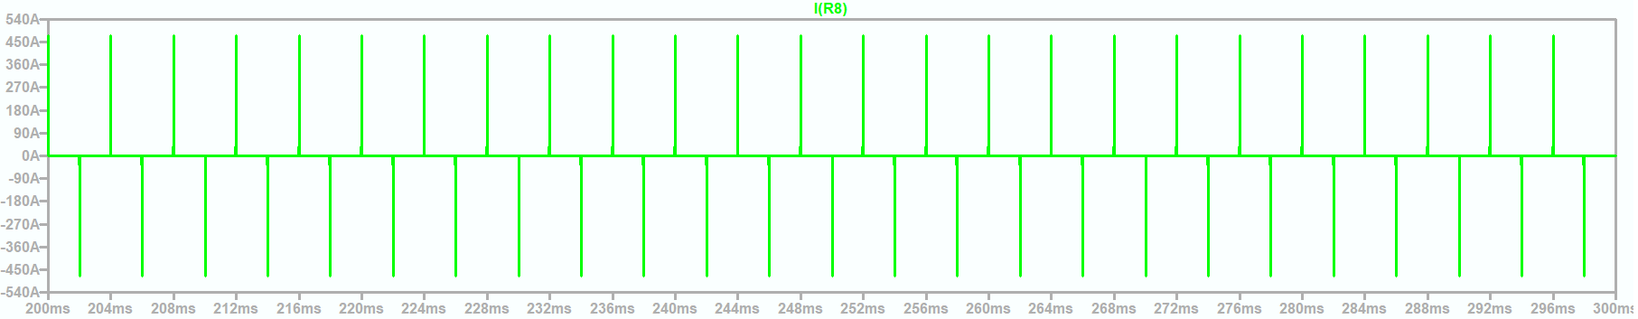
Comparison to Part 5 results
120 ° Mode – Common Mode Current
With Common Mode Choke
Without Common Mode Choke

Slide 13
Wrap up

